Slide 1
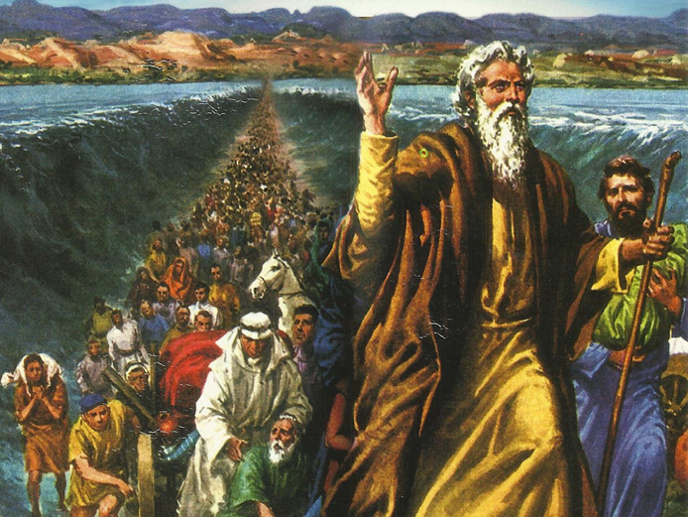
CATECHETICAL TEXTBOOK SERIES OF THE SYRO - MALABAR CHURCH
ON THE PATH OF SALVATION - 5
PEOPLE WHO AWAITED THE REDEEMER
5

Slide 2
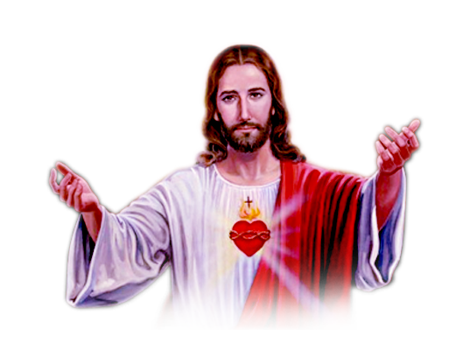
LESSON 15
PROMISES AND PROPHESIES ABOUT CHRIST

Slide 3
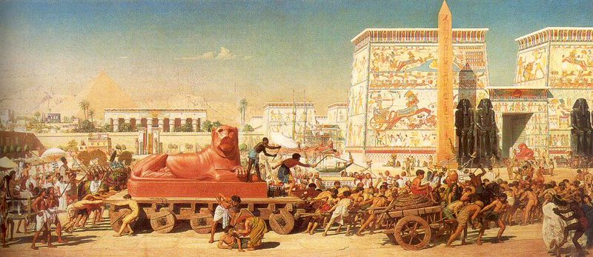
Prophets worked among the people of Israel for about a thousand years. God sent them. They constantly reminded the people of the need to keep untainted their faith in one God and to live according to the covenant that God had made with Israel. They tried to guide even the kings along the right path. The prophets warned that God would punish the people of God who live forgetting God and His commandments. At the same time they prophesied that God would never forsake Israel totally. When the kings of Israel ruled without heeding the instructions of the prophets, foreigners subjugated the nation. Quarrels and disquiet spread across the nation. The people longed for redemption. At that time, giving the message of love, the prophets told the people about Christ the saviour. The word ‘Christ’ means ‘the anointed’.

Slide 4
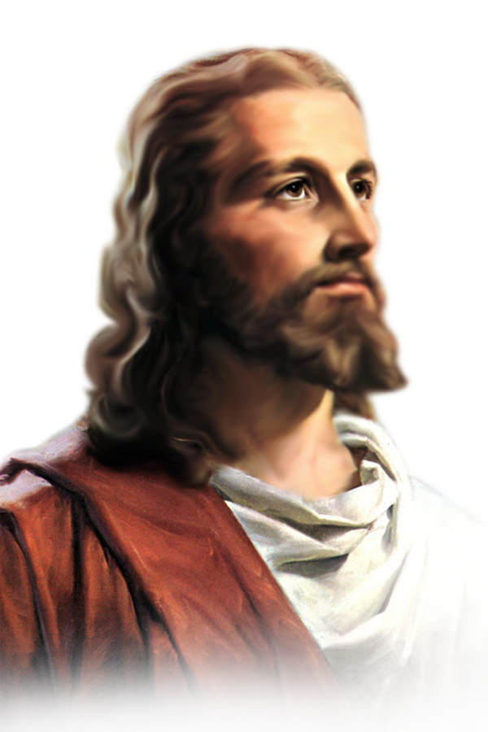
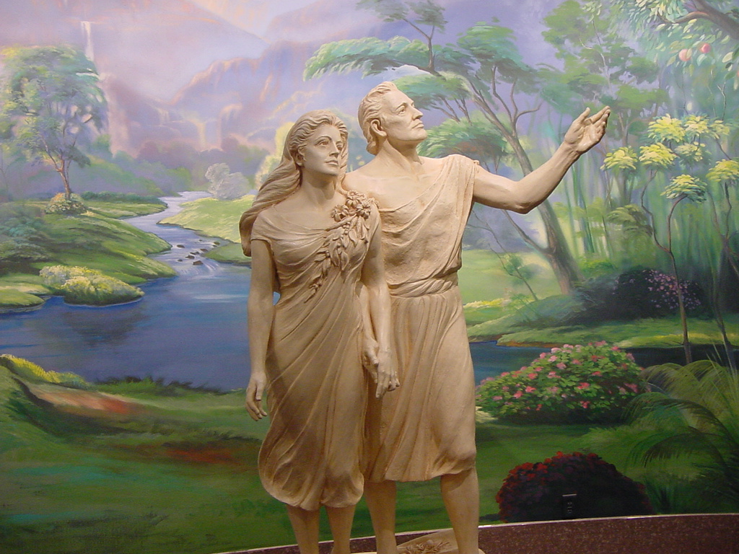
Promises about the saviour
“ I will put enmity between you and the woman, and between your offspring and hers, he shall strike your head…” (Gen. 3:15).
“ The Lord says: I will raise up for them a prophet like you from among their own people; I will put my words in the month of the prophet, who shall speak them everything that I command” (Deut. 18:18).

Slide 5
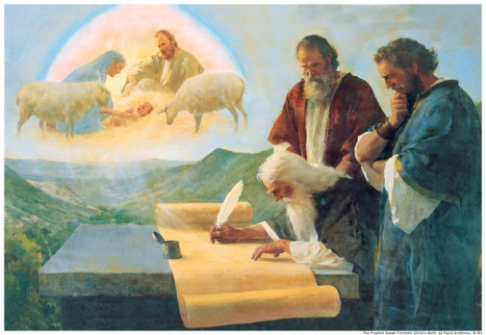
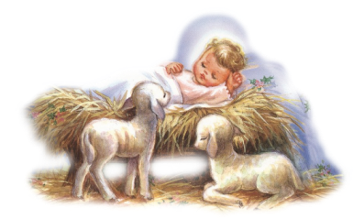
Prophesies about the saviour
Prophesies of isaiah
‘Immanuel prophesy’ of Isaiah. A young woman is with child and shall bear a son, and shall name him Immanuel’ (Isaiah 7:14) “ For a child has been born for us, a son given to us; authority rests upon his shoulders; and he is named Wonderful Counselor, Mighty God, Everlasting Father, Prince of Peace. His authority shall grow continuously, and there shall be endless peace for the throne of David and his kingdom” (Isaiah 9:6-7).
The word ‘Immanuel’ means ‘God with us’.
“… He has anointed me to bring good news to the poor….”
(Isaiah 61:1, Luke 4:18).

Slide 6
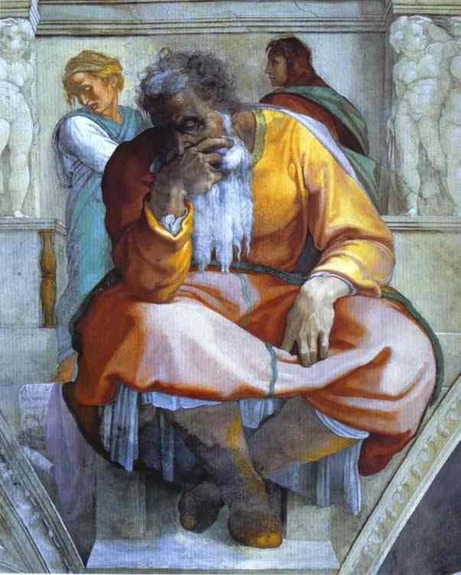
Prophesies of jeremiah
“ The days are surely coming, says the Lord, when I will fulfil the promise I made to the house of Israel and the house of Judah. In those days and at that time I will cause a righteous Branch to spring up for David: and he shall execute justice and righteousness in the land. In those days Judah will be saved and Jerusalem will live in safety…. David shall never lack a man to sit on the throne of the house of Israel” ” (Jeremiah 33: 14-17).

Slide 7
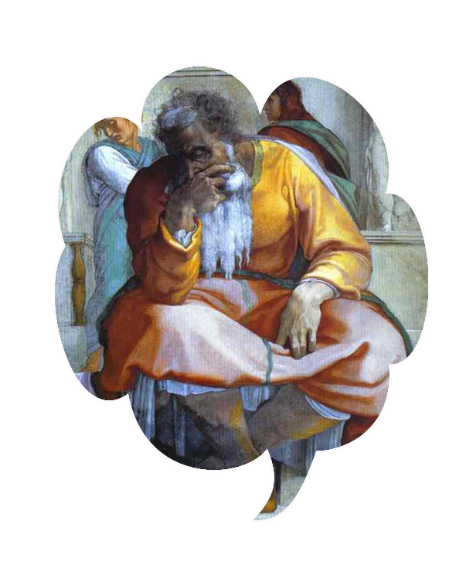
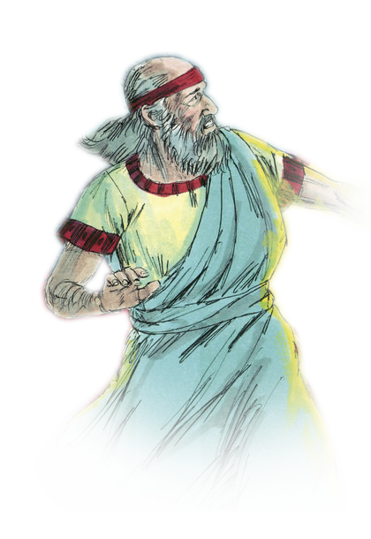
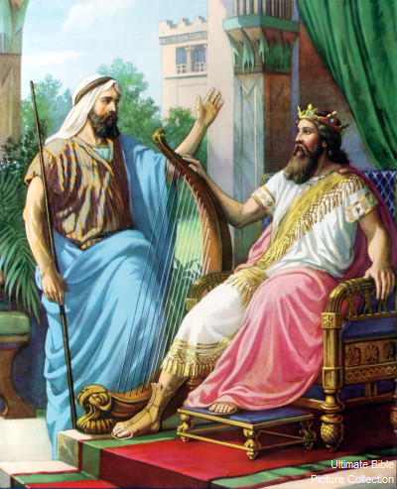
Other prophets also gave clear references regarding Christ. Prophets Nathan and Jeremiah pointed out Christ’s Lineage to David. Prophet Micah said that the Christ existed for ages. Prophet Zechariah presents Christ as the king who comes in humility riding a young donkey. Prophet Ezekiel describes the Christ who is to come, as a good shepherd.

Slide 8
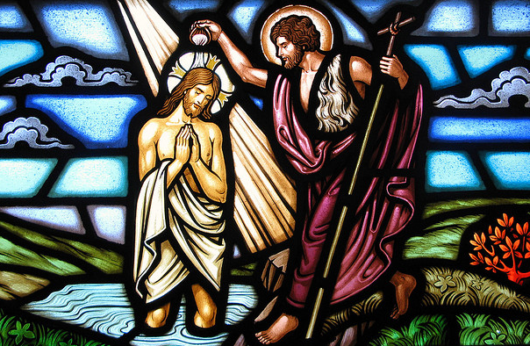
Witness of john the baptist
“ prepare the way of the Lord, Make his paths straight. Every valley shall be filled, and every mountain and hill shall be made low, and the crooked shall be made straight, and the rough ways made smooth: and all flesh shall see the salvation of Go” (Luke 3:4-6).
The next day, seeing Jesus coming towards him, John the Baptist declared: “ Here is the lamb of God who takes away the sin of the world! This is he of whom! Said, after me comes a man who ranks ahead of me because he was before me” (Jon. 1:29-30).

Slide 9
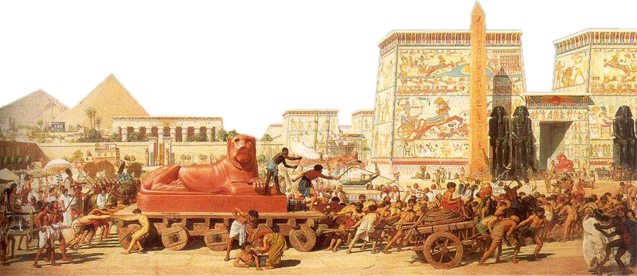
Fulfillment of the prophesies
All the prophecies were fulfilled in Jesus. The Old testament people awaited Jesus. Their history culminated in the birth of Jesus. With the birth of Jesus the New Testament people came into being. It is the New testament people who could enjoy the peace and the kingdom of the saviour, which the Old Testament people awaited with great expectations. Through Moses the old Israel was liberated from slavery in Egypt. Jesus liberated mankind from the bondage of darkness and gave rise to the New Israel. Thus the plan of salvation that started in the Garden of Eden continued through the Old Testament and reached completion in the New Testament.

Slide 10
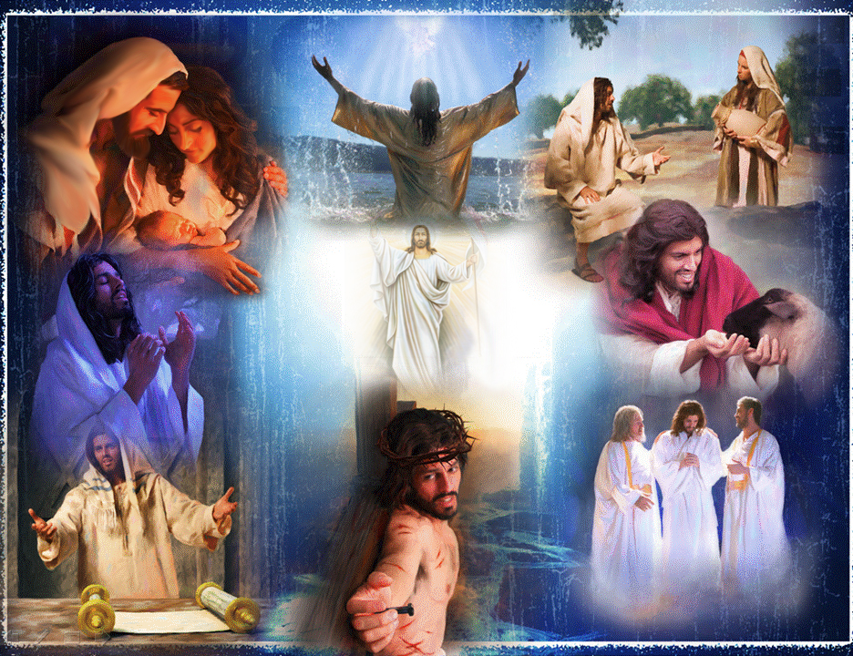
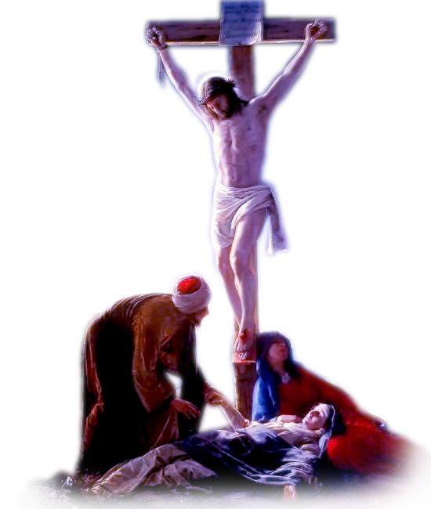
Fulfillment of the prophesies
We enjoy the fruits of God’s plan of redemption, We must claim for ourselves, joyfully and gratefully, the redemption that Jesus obtained for us through his Crucifixion. We must lead our lives with the awareness of freedom that we are the children of God. Thus we can reach heaven one day and lead eternal life.

Slide 11
Let us pray
O Jesus, the fulfilment of all prophecies, help us to accept you as our saviour.

Slide 12
READ AND RECOUNT
Narrate the event of the birth of Jesus. (Mathew 1: 18-25)

Slide 13

WORD OF GOD FOR GUIDANCE
“ He must increase and I must decrease” (John 3:30).

Slide 14
MY DECISION
Like John the Baptist, who introduced Jesus to the world, I will also introduce Jesus to my friends.

Slide 15
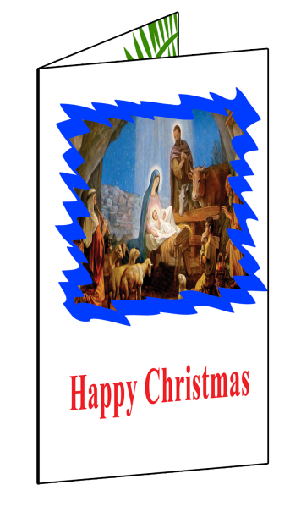

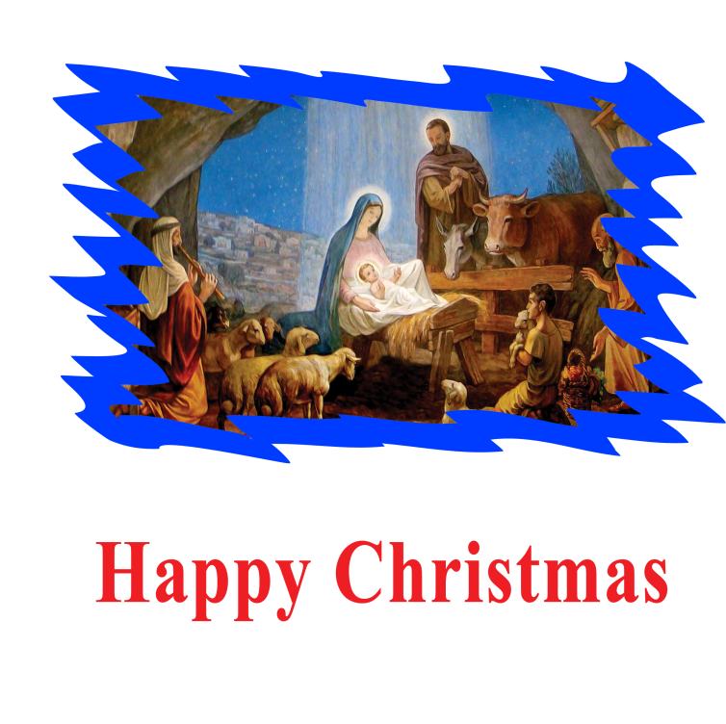

LET US DO
Make a Christmas greeting card

Slide 16
LET US FIND OUT THE ANSWER
1. With is the meaning of the word Messiah?
2. What is important of all the prophecies of Isiah?
3. When did the Emmanuel prophecy fulfill?
4. What for the last prophet, John the Baptist was sent?
5. What did John the Baptist say seeing Jesus coming to him?

Slide 17
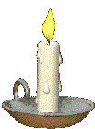


Thank you

